Slide 1
Lecture
Sequential circuits, flip-flops

Slide 2
Sequential Circuits
Combinational logic circuits are perfect for situations when we require the immediate application of set of inputs.
However, when we need a circuit to change its value with consideration to its current state as well as its inputs.
  These circuits have to “remember” their current state.
Sequential logic circuits provide this functionality for us.

Slide 3
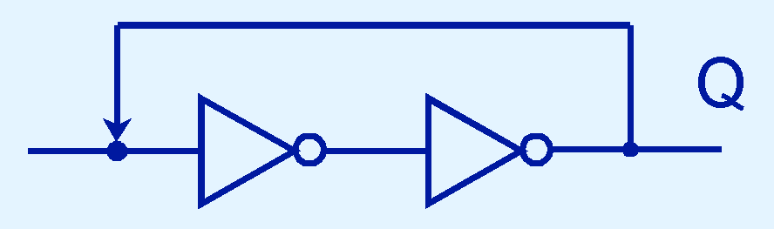
Sequential Circuits
To retain their state values, sequential circuits rely on feedback.
Feedback in digital circuits occurs when an output is looped back to the input.
A simple example of this concept is shown below.
  If Q is 0 it will always be 0, if it is 1, it will always be 1. Why?

Slide 4
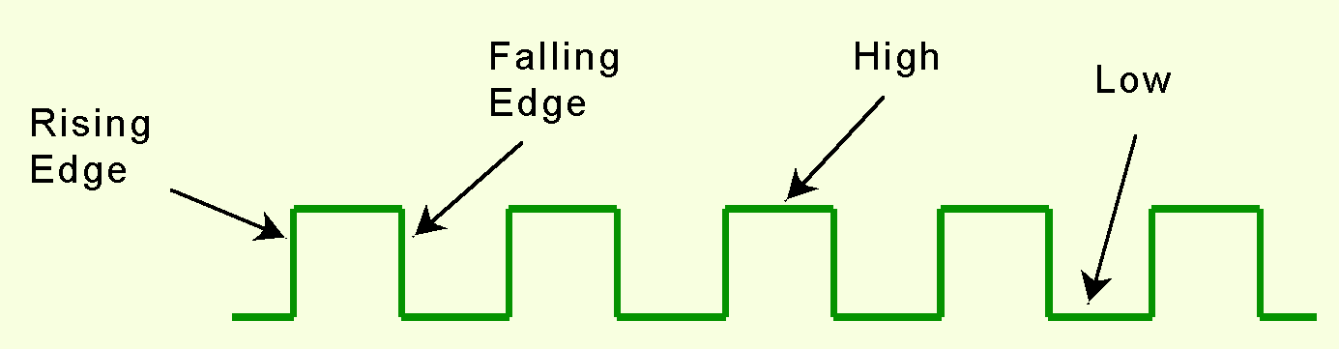
Sequential Circuits
State changes occur in sequential circuits only when the clock ticks.
Circuits can change state on the rising edge, falling edge, or when the clock pulse reaches its highest voltage.

Slide 5
Sequential Circuits
Circuits that change state on the rising edge, or falling edge of the clock pulse are called edge-triggered.
Level-triggered circuits change state when the clock voltage reaches its highest or lowest level.

Slide 6
Flip-Flop
Latch is a one-bit storage unit. Clocked latch is known as flip flop.
These are:
SR flip-flop
D flip-flop
JK flip-flop
T filp-flop

Slide 7
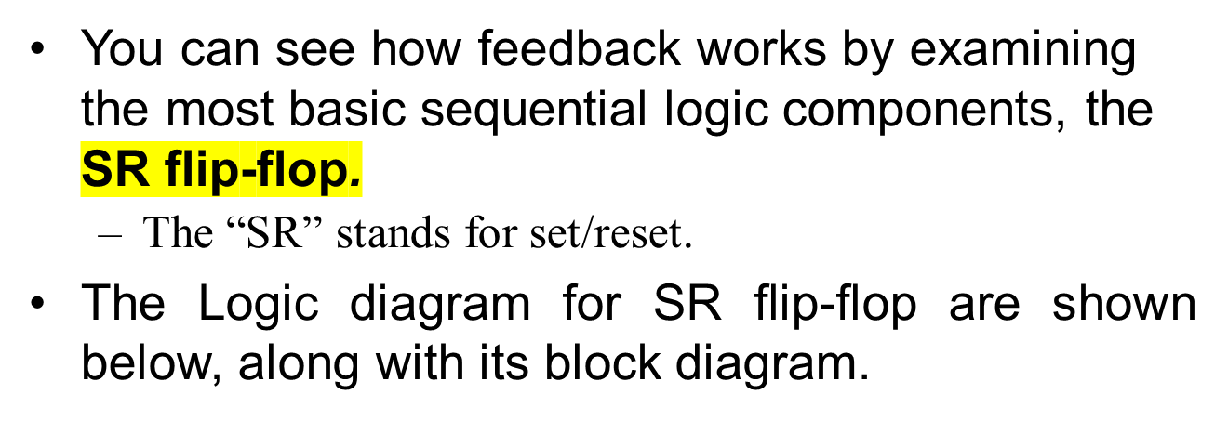
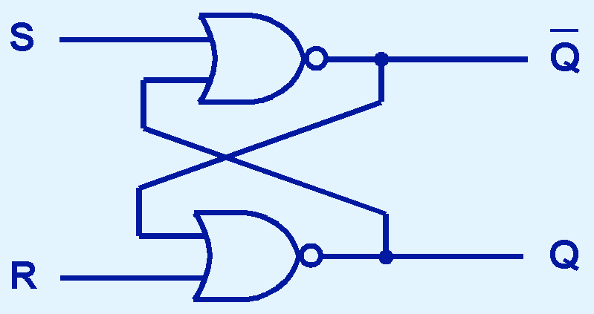
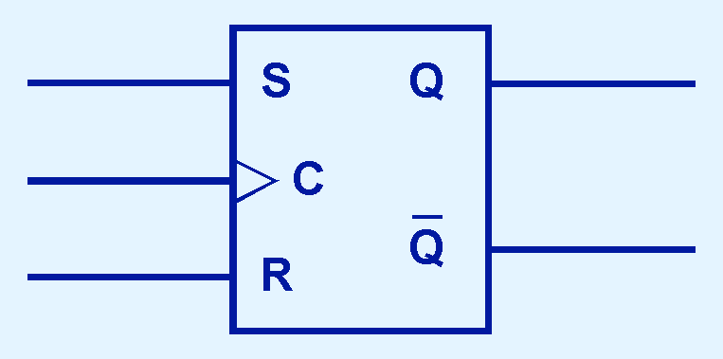
Sequential Circuits; ( SR Latch)

Slide 8
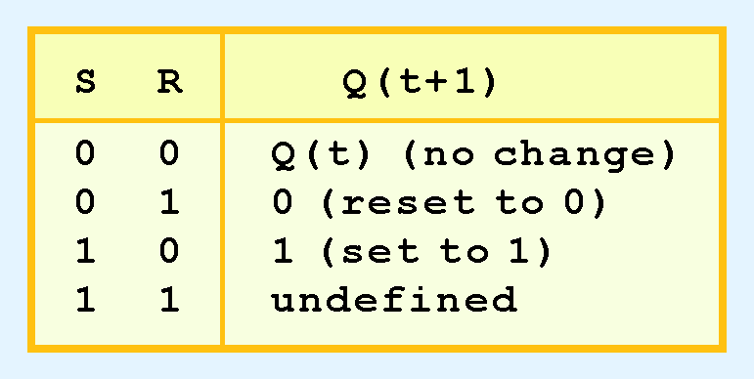
Sequential Circuits
The behavior of an SR flip-flop is described by a characteristic table.
Q(t) means the value of the output at time t. Q(t+1) is the value of Q after the next clock pulse.

Slide 9
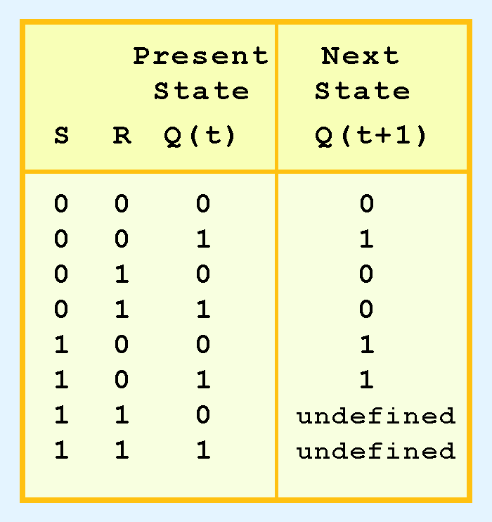
Sequential Circuits
The SR flip-flop actually has three inputs: S, R, and its current output, Q.
we can construct a truth table for this circuit, as shown at the right.
Notice the two undefined values. When both S and R are 1, the SR flip-flop is unstable.

Slide 10
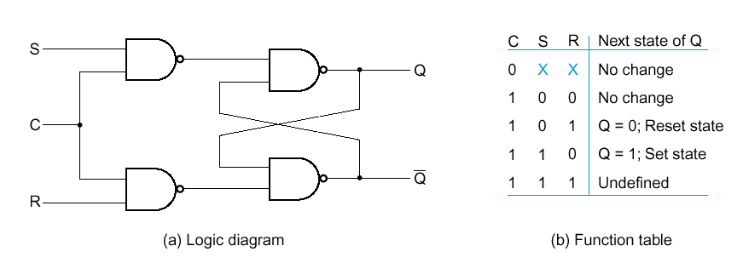
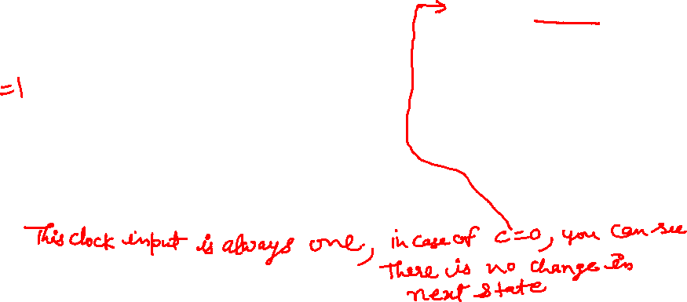
SR Latch with Clock signal
Latch is sensitive to input changes ONLY when C=1
PJF - <number>
Sequential Circuits

Slide 11
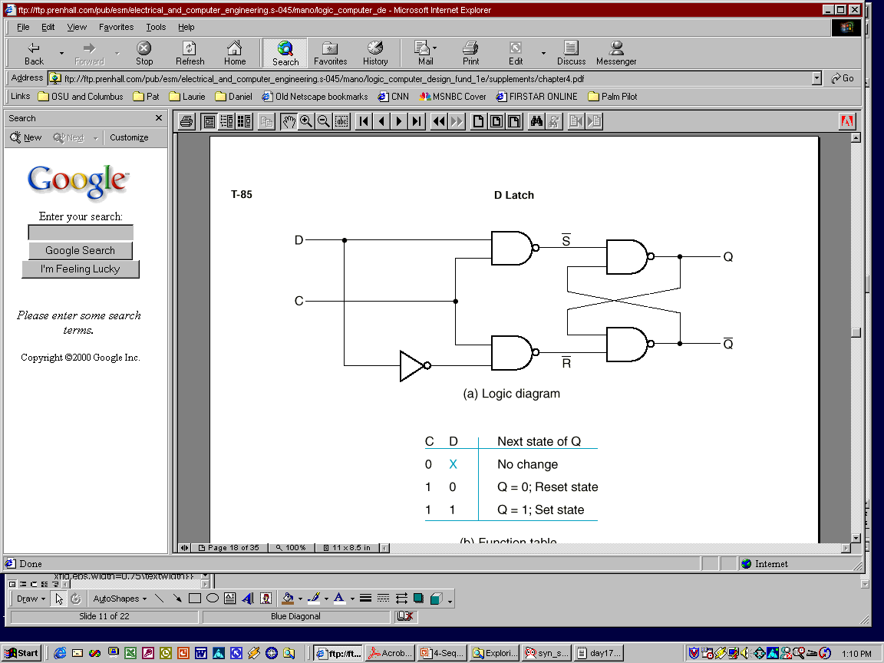
D Latch with clocked signal
One way to eliminate the undesirable indeterminate state in the RS flip flop is to ensure that inputs S and R are never 1 simultaneously. This is done in the D latch:
Sequential Circuits

Slide 12
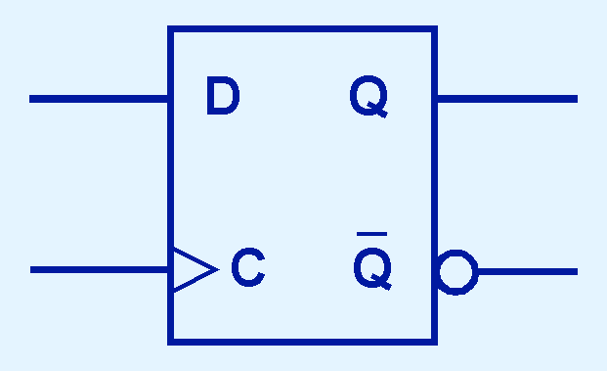
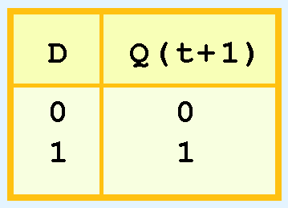
Sequential Circuits; ( D flip flop)
The D flip-flop is the fundamental circuit of computer memory.
  D flip-flops are usually illustrated using the block diagram shown below.
The characteristic table for the D flip-flop is shown at the right.

Slide 13
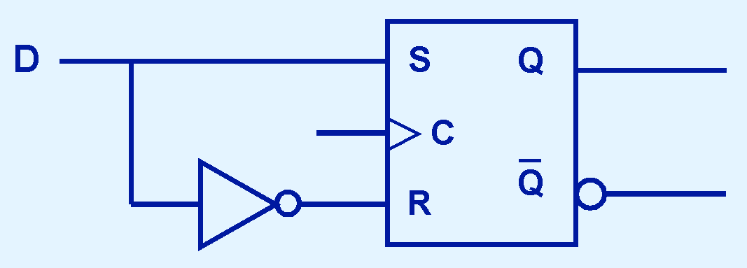
Sequential Circuits; ( D flip flip)
Another modification of the SR flip-flop is the D flip-flop, shown below with its characteristic table.
You will notice that the output of the flip-flop remains the same during subsequent clock pulses. The output changes only when the value of D changes.

Slide 14
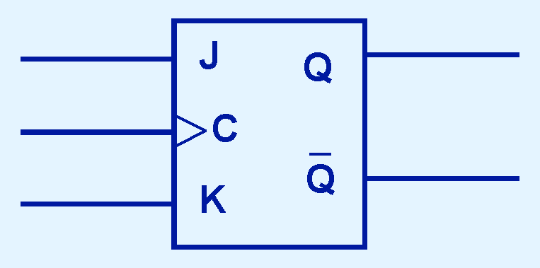
Sequential Circuits; ( JK flip-flop)
If we can be sure that the inputs to an SR flip-flop will never both be 1, we will never have an unstable circuit. This may not always be the case.
The SR flip-flop can be modified to provide a stable state when both inputs are 1.
• This modified flip-flop is called a JK flip-flop, shown at the right.

Slide 15
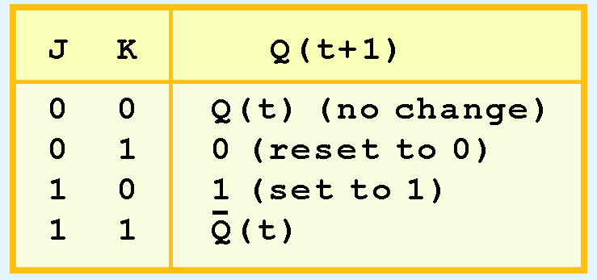
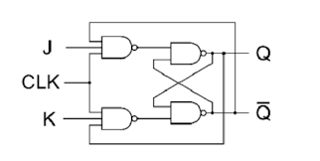
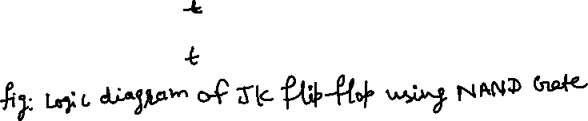
Sequential Circuits; ( JK flip – flop)
The characteristic table indicates that the JK flip-flop is stable for all inputs.

Slide 16
Sequential Circuits; ( T flip–flop)
T flip – flop is also known as “Toggle Flip – flop”. To avoid the occurrence of intermediate state in SR flip – flop, we should provide only one input to the flip – flop called Trigger input or Toggle input (T). Then the flip – flop acts as a Toggle switch. Toggling means ‘Changing the next state output to complement of the present state output’.

Slide 17

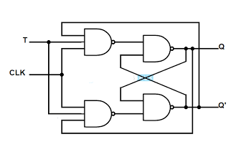
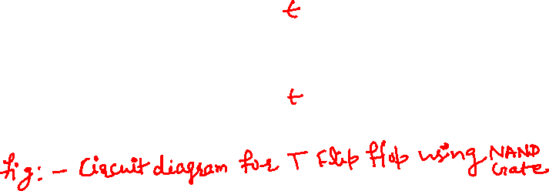
Sequential Circuits; ( T flip–flop)

Slide 18
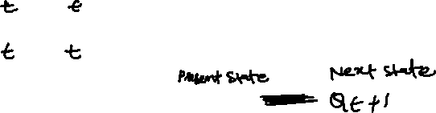
Sequential Circuits; ( T flip–flop)
Full name: Toggle flip-flop
Output toggles when input is asserted
  If T=1, then Q → Q' when CLK ↑
  If T=0, then Q → Q when CLK ↑
^{Input}
^{Q}
Input(t) Q(t) Q(t + Δt)
^{T}
^{Q}
>
⁰
⁰
⁰
⁰
¹
¹
^{CLK}
¹
⁰
¹
¹
¹
⁰

Slide 19
Conclusion
The behavior of sequential circuits can be expressed using characteristic tables or through various finite state machines.
Sequential circuits require clocks to control their changes of state.
The basic sequential circuit unit is the flip-flop: The behaviors of the SR, JK, and D flip-flops are the most important to know.

Slide 20
Thanks

